Slide 1
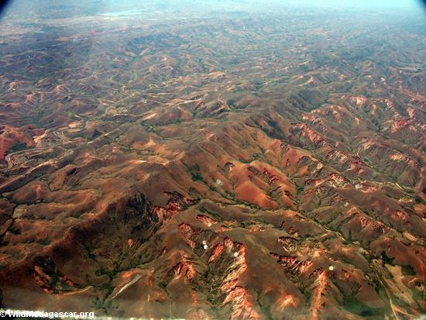
Who?
What?
Where?
Why?
When?
Using the 5Ws above, produce questions related to this photograph
e.g. Where is it?

Slide 2
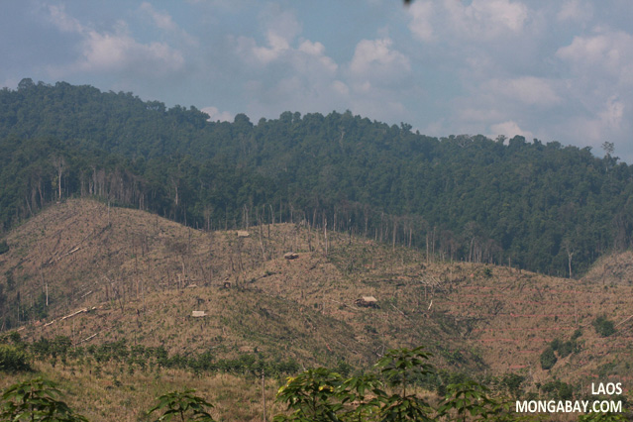
Deforestation in Madagascar:
Should it continue?
To describe the cause and effect of deforestation, analyse opinions and evaluate the impact
AF4 – explain how management can reduce impacts
AF5 – evaluate impact of deforestation

Slide 3
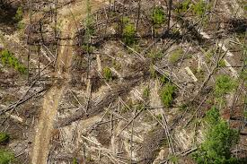
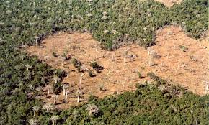
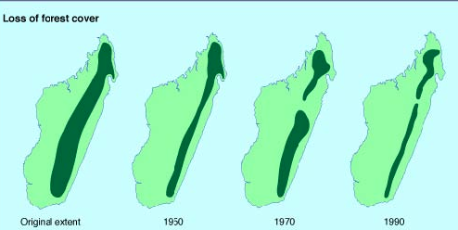
What is deforestation?
Deforestation is the cutting down of trees transforming a forest into cleared land.

Slide 4
COPY: In Madagascar, one of the world’s poorest countries, pressure on the tropical rainforest is accelerating and having a massive impact on its diversity. It is amongst the world’s most biologically diverse places with high levels of endemic (found nowhere else) plants and animals.

Slide 6
Cause/Effect of Deforestation
Sort the following statements in to CAUSE and EFFECT
Global Warming
Railroad construction
Loss of habitats
Population growth
Selective Logging
Fuel
Soil Erosion
Lightning
Farming
Mining
Land for housing and development
Cattle Ranching
To harvest timber for commercial items e.g. paper
Medicines
Loss of species
Key words:
Selective logging = selecting the tree to cut down. This may involve cutting down many trees to reach the one needed.
EXTENSION:
Sort the causes in to HUMAN AND PHYSICAL and the effects in to POSITIVE AND NEGATIVE
Who/what is the main cause? Are the effects mainly positive or negative? Why do you think this might be?

Slide 7
Deforestation: Opinions
In groups of 2/3, you will be representing a different stakeholder (a group of people with an interest in the Tropical Rainforest)
In role, you will be deciding as a group your opinion towards deforestation - should it be allowed to continue? You must justify your decision with at least 4 reasons. You will be given some information to start, but you will need to do further research to clarify the justification. Prepare to feedback to the class next lesson.
Complete your section of the table when you have finalised your decisions
STAKEHOLDERS:
Environmentalists
Government
Mining Company
Pharmaceutical Company
Ranomafana National Park Manager
Local person
Suggest how deforestation could be managed, sustainably, to reduce the negative effects. EXTENSION: What factors may influence the decision about sustainable management?

Slide 8
Success
Criteria
Deforestation in Madagascar:
Should it continue?
AF4 – explain how management can reduce impacts
AF5 – evaluate impact of deforestation

