Slide 1
Explaining the development indicators
LO: To be able to explain how the indicators of development provide information on how developed a country is

Slide 2
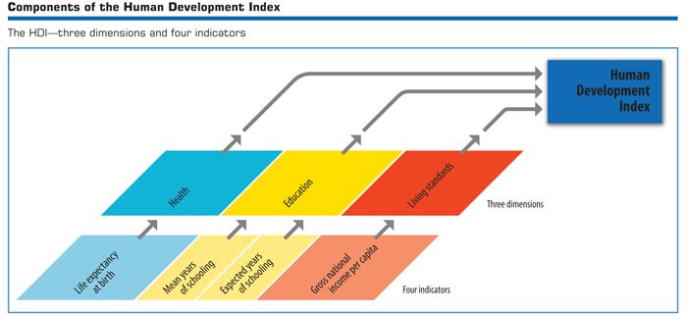
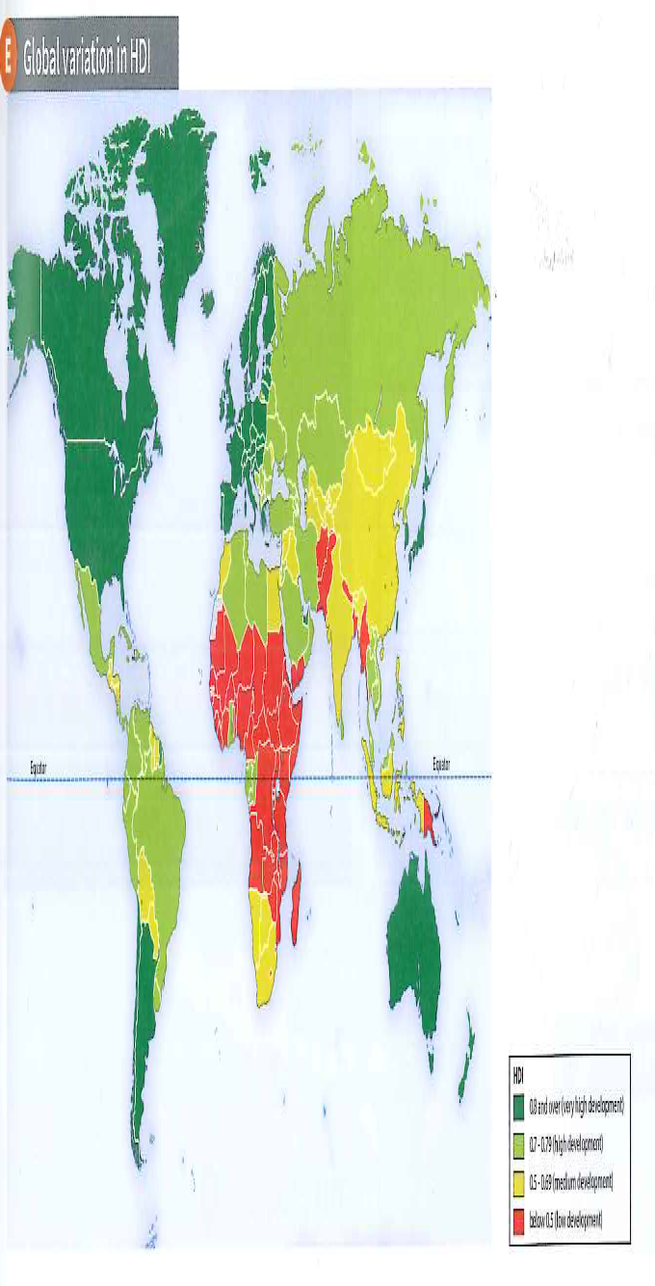
Human Development Index (HDI)
To define and explore the HDI
Uses 3 development indicators to give each country a score on an index from 0 to 1.
A score closer to 1 are the most developed countries, while those with a lower score are the least developed.
The 4 indicators are: life expectancy, mean and expected years of schooling and GNI per capita.
It then classifies the countries into
4 bands: very high, high, medium and low human development.

Slide 3
Describe the distribution of HDI
Describe the distribution of those countries with:
Very high development
High development
Medium development
Low development
Remember the rule for describing:
Pattern
Data
Anomaly

Slide 5
Choose two Social indicators and two economic indicators and explain how each one helps to explain how developed a country is…
GNI or GNI per capita
% employed in primary, secondary, tertiary or quaternary
Literacy rate
% of people per doctor
Life expectancy
Infant mortality
The ……………… indicates a countries level of development because ……… This means that………. and therefore…………. furthermore……….

