Slide 1
Measuring Quality of Life
LO:
To understand a range of indicators that explain a persons quality of life

Slide 2
Recap
What is development?
How do we measure development?
What is a composite measurement?
What is quality of life? How is it different?

Slide 4
Where to be born Index (previously known as quality of life index)
Uses 10 indicators to measure quality of life – ranks countries between 1-10, 10 being the highest
Material well-being as measured by GDP per capita
Life expectancy at birth
The quality of family life based primarily on divorce rates
The state of political freedoms
Job security (measured by the unemployment rate)
Climate (measured by two variables: the average deviation of minimum and maximum monthly temperatures from 14 degrees Celsius; and the number of months in the year with less than 30mm rainfall)
Personal physical security ratings (based primarily on recorded homicide rates and ratings for risk from crime and terrorism)
Quality of community life (based on membership in social organisations)
Governance (measured by ratings for corruption)
Gender equality (measured by the share of seats in parliament held by women)

Slide 5
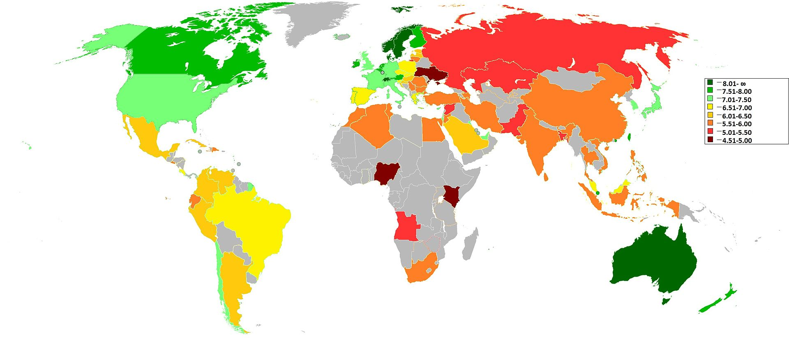
Task: Describe what this map tells you about quality of life

Slide 6
2013 rankings

Slide 7
Exam question Practice
‘ Explain how the quality of life might vary between one named LIC and one named HIC’ (6)
Try to include well developed explanations like this…
The quality of life in a country might be affected by employment rate. This is because having job security means that people feel safe and confident that they will have a disposable income. Therefore they can enjoy their leisure time and will be able to afford to live a comfortable life. For example, in a HIC such as…. Australia the chances of being employed are higher therefore people have a better quality of life.

Slide 8
Marking criteria – Peer Assessment
Names and gives suitable examples of LIC/HIC
Uses several relevant (QoL) indicators to explain differences, such as life expectancy, low levels of crime, gender equality
Makes point that QoL is more than just economic development, it can indicate happiness, life satisfaction etc
Uses good connective language to explain key differences e.g. ‘whereas’, ‘therefore’, ‘this means that’…
Each point is well developed and uses appropriate terminology and correct grammar etc

Slide 10
Which qualities are most important to you?
Which qualities are most important to you?
Quality | Importance 1-10
Ability to buy materialistic items
How long you can expect to live
Whether your parents stay married
Freedom to speak out against the government
Being able to secure a good Job
The type of climate you live in
Your physical safety
Being able to attend social activities with friends
That women have the same equal rights as men
Quality | Importance 1-10
Ability to buy materialistic items
How long you can expect to live
Whether your parents stay married
Freedom to speak out against the government
Being able to secure a good Job
The type of climate you live in
Your physical safety
Being able to attend social activities with friends
That women have the same equal rights as men
Can you think of another quality not listed?
………………………………………………………………………………
...................................................................................
……………………………………………………………………………….
Can you think of another quality not listed?
………………………………………………………………………………
...................................................................................
……………………………………………………………………………….

