Slide 1
The Changing Pattern of Global Development
LO:
Describe the global pattern of countries at different levels of economic development.
Be able to explain how this pattern in changing
https://www.youtube.com/watch?v=jbkSRLYSojo

Slide 2
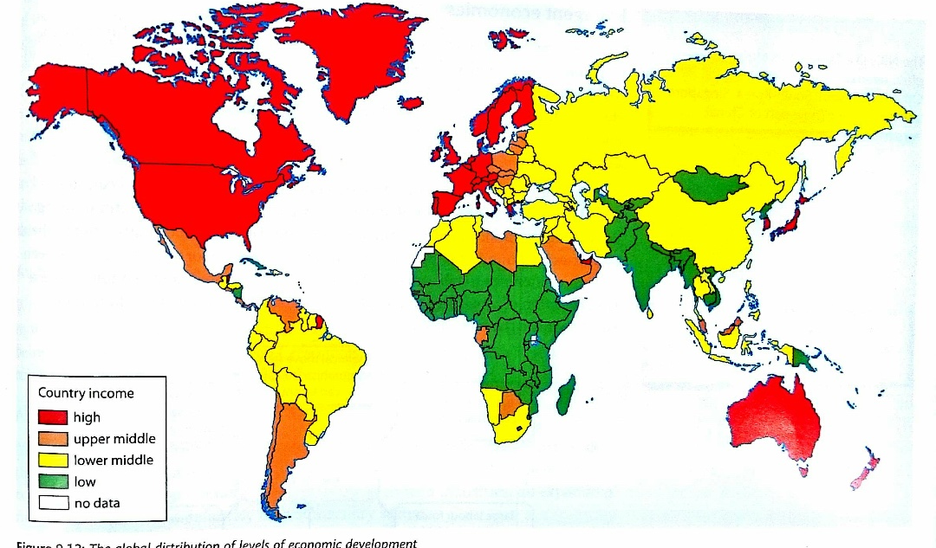
World Bank’s GNI classification

Slide 3
Task: read pages 249 -251
Describe how the World Bank classifies countries according to GNI
MICs are often referred to as emergent economies, what does this mean?
Explain how emergent economies are separated into two types
What are the Asian Tigers?
What are the BRIC economies, why are they so significant?
Explain how the global shift in manufacturing has helped some countries develop
What has allowed China to develop so rapidly?
What is a Stagnant economy? Give an example
Give two reasons why some countries remain stagnant?
What is an Awakening economy? Example?
What is allowing advanced HIC economies to continue to advance, even with a loss of manufacturing?

Slide 4
Task: read pages 249 -251 answer the following in your books
Task: read pages 249 -251 answer the following in your books
Describe how the World Bank classifies countries according to GNI
MICs are often referred to as emergent economies, what does this mean?
Explain how emergent economies are separated into two types
What are the Asian Tigers?
What are the BRICs economies, why are they so significant?
Explain how the global shift in manufacturing has helped some countries develop
What has allowed China to develop so rapidly?
What is a Stagnant economy? Give an example
Give two reasons why some countries remain stagnant?
What is an Awakening economy? Example?
What is allowing advanced HIC economies to continue to advance, even with a loss of manufacturing?
Describe how the World Bank classifies countries according to GNI
MICs are often referred to as emergent economies, what does this mean?
Explain how emergent economies are separated into two types
What are the Asian Tigers?
What are the BRICs economies, why are they so significant?
Explain how the global shift in manufacturing has helped some countries develop
What has allowed China to develop so rapidly?
What is a Stagnant economy? Give an example
Give two reasons why some countries remain stagnant?
What is an Awakening economy? Example?
What is allowing advanced HIC economies to continue to advance, even with a loss of manufacturing?

Slide 5
Know your abbreviations!

Slide 6
LLEDCs

Slide 7
MEDCs

Slide 8
LICs

Slide 9
MICs

Slide 10
HICs

Slide 11
RICs

Slide 12
NICs

Slide 13
BRICS

Slide 14
GNI

Slide 15
GPD

Slide 16
HDI

