Slide 1
Development Gaps
LO:
To outline regional disparities within one country and explain the causes, consequences and management of these regional disparities

Slide 2
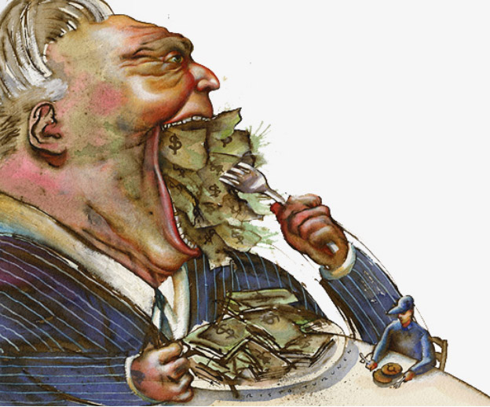
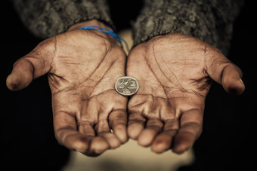
What is a development gap?
‘It is the difference in ‘standard of living’ between the highest and lowest developed countries and regions in the world. It is argued that the gap is widening as rich countries continue to get richer while many poor countries do not’
People believe the gap is increasing

Slide 3
Regional Disparities
Development gaps can also occur within countries, as there are often wide gaps between the richest and poorest within some regions.
Many countries have what is known as a
Core: A concentrated area of high economic development and prosperity
&
Periphery: A poorer region with less economic growth

Slide 4
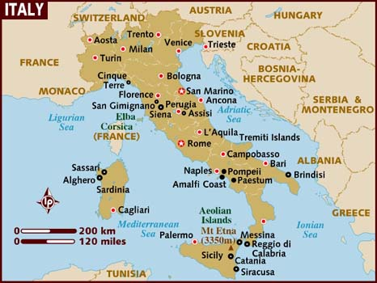
Case Study of regional disparity: Italy
Italy has a very obvious north/south divide in terms of its economic development.
Task: Read the case study in the text book and complete the information sheet.

