Slide 1
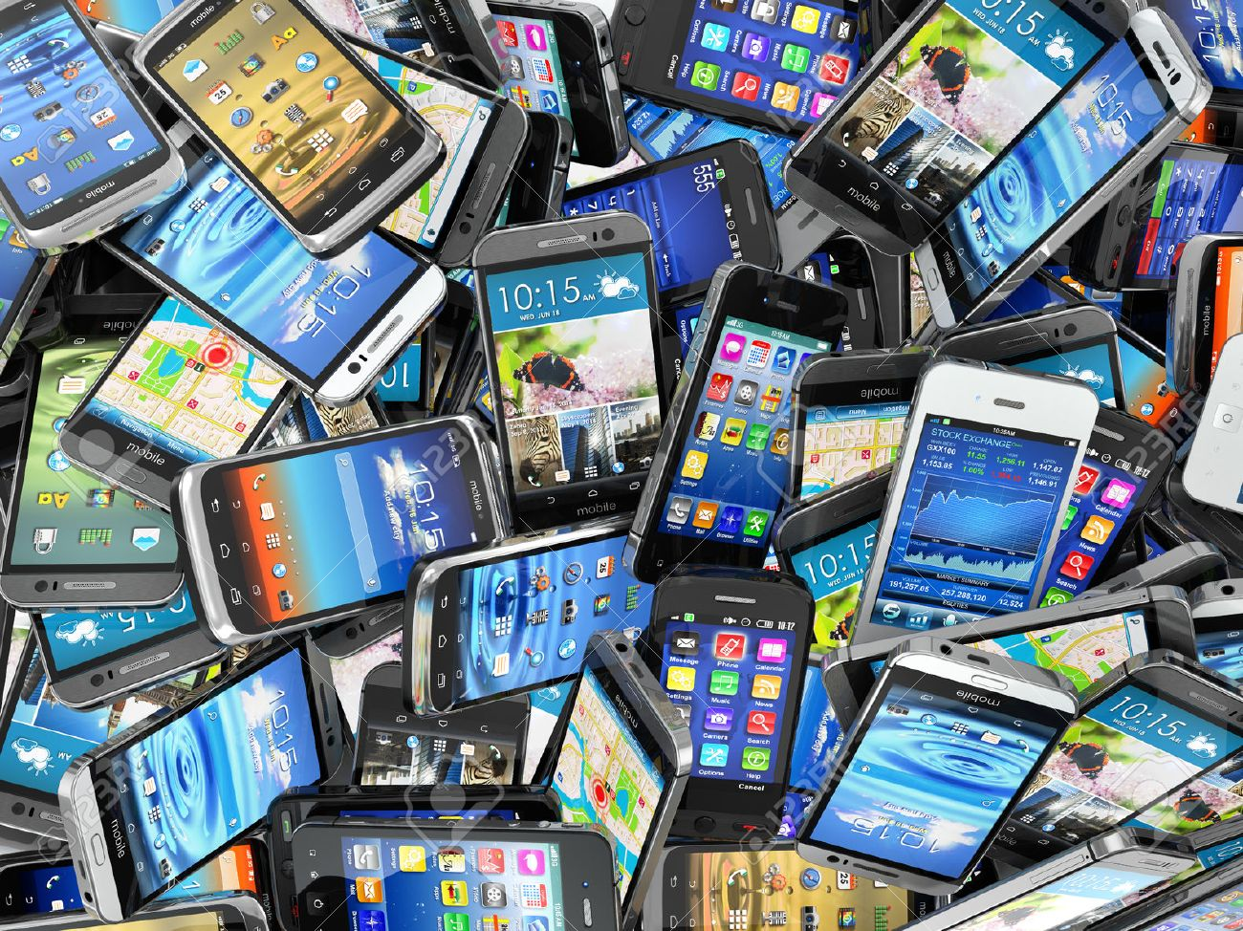
DO NOW TASK: Complete the task. Leave space for Title, Date and LO.
What are the benefits of owning a mobile phone?
Create a list of ideas.

Slide 2

Title: How the mobile phone changed Africa
Date: Monday, November 18, 2019
WTE - To identify S.E.E impacts of mobile phone use.
ME - To explain how mobile phones can benefit the continent of Africa.
EE - To explain and evaluate the advantages and disadvantages that modern technology brings to Africa.
AF5: EVALUATE

Slide 3

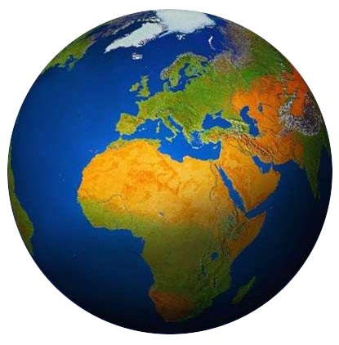
KEYWORD:
Globalisation: The world becoming increasingly interconnected due to increasing trade and improved transport and technology
Technology is making developing nations more connected with the world around them.
Challenge question: Will the world continue to become more globalised because of technology?
Learning Objective: To evaluate the advantages and disadvantages that modern technology brings to Africa.

Slide 4

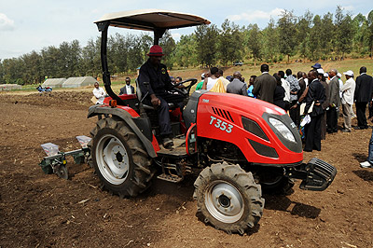
Watch the video.
How is technology benefitting different people in Uganda, Africa?
KEYWORDS:
Subsistence farming – Grow crops to feed your family.
Commercial Farming – growing and selling crops to make an income.
Poverty - When a persons basic needs (food/ shelter/ water) are not met.
Video 1
Learning Objective: To evaluate the advantages and disadvantages that modern technology brings to Africa.

Slide 5
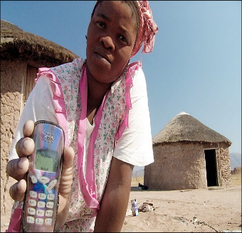
“Kenya's mobile phone industry is booming. Mr Kibaki said that more than 13 million Kenyans owned mobile phones, compared with less than 20,000 in October 2000. “At this pace of growth, we expect to realise 20 million subscribers in the next three years,” he said.” (Quote from President Kibaki at the start of the Safaricom shares sale in March 2008.)
"The mobile has made us equal," Molu Kulu, a Masai village elder said. "It is not like the landline, which was only available in some homes, or the phone booth, which was available in trading centers. Now everyone can communicate."
Complete the task sheet.
You must select Secure Knowledge or Meeting Expectation task first

Slide 6

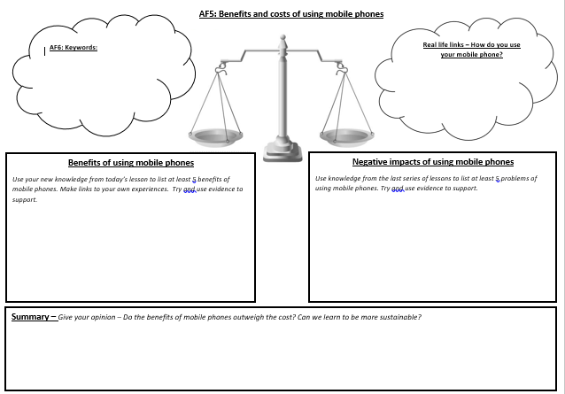
Preparing our AF5: Evaluate answer
Learning Objective: To evaluate the advantages and disadvantages that modern technology brings to Africa.

