Slide 1
LONGITUDE & LATITUDE
#whataretheselinesusedfor?

Slide 2
LEARNING OBJECTIVES
TITLE: LONGITUDE & LATITUDE
DATE:
AF2/: TO UNDERSTAND HOW TO CALCULATE THE LONGITUDE & LATITUDE OF PLACES.
ALL (WTE/WTE+) STUDENTS WILL BE ABLE LOCATE EITHER THE LONGTITUDE OR LATITUDE OF GIVEN LOCATIONS.
MOST (ME/ME+) STUDENTS WILL BE ABLE TO LOCATE BOTH THE LONGITUDE & THE LATITUDE FOR VARIOUS LOCATIONS.
SOME (EE/EE+) STUDENTS WILL BE ABLE TO FULLY DESCRIBE THE LOCATION OF THE 7 CONTINENTS & OCEANS & EXPLAIN THEIR KEY FEATURES.
LEARNING OUTCOMES
SCF: Communication & Collaboration

Slide 3
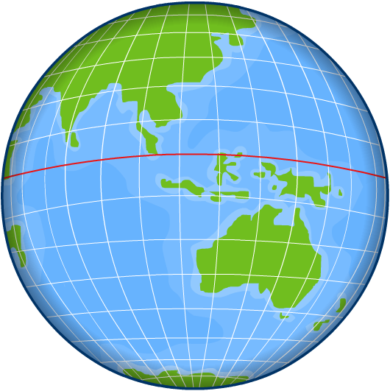
Locating places
The Earth is like a giant ball, so how can we describe where a point is on it?
A system of lines is used to locate any place on the surface of the Earth.
Lines of latitude run in an east–west direction and allow us to say how far we are north or south.
Lines of longitude run from north to south and allow us to say where we are, east or west.

Slide 4
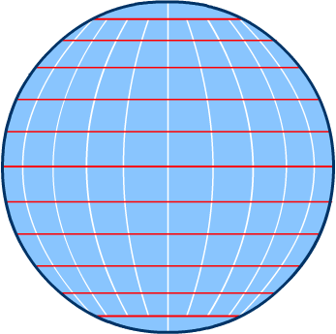
Latitude
Lines of latitude are the equally spaced horizontal lines on a model globe and on the maps in an atlas.
Sometimes these lines are called parallels because they are all aligned in one direction.
There are 89 of them to the north of the Equator and 89 to the south.
The Equator is the line of latitude around the middle of the Earth.
Where the 90th line would be are two points, the North and South Poles.

Slide 5
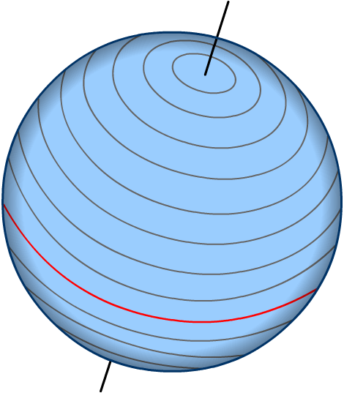
The equator and the poles
Latitude is measured in degrees north or degrees south of the Equator:
North Pole
the Equator lies at 0°
60°
50°
40°
90°
30°
80°
the North Pole is found at 90°N
70°
20°
10°
the South Pole is found at 90°S
Equator
0°
all other latitudes have a value between 0° and 90° north or south.
90°
South Pole
Notes:
Teacher’s note: It could be helpful to discuss minutes and seconds. Degrees of latitude and longitude can be divided into sixtieths, or minutes ('). Any location on Earth can be described as lying at a certain number of degrees and minutes of latitude either north or south of the equator and at a certain number of degrees and minutes of longitude either east or west of the prime meridian. For example, the United States Capitol in Washington D.C. is at 38 degrees 53 minutes north latitude (38° 53' N.) and 77 degrees 0 minutes west longitude (077° 00' W.). Minutes of latitude and longitude can be divided into sixtieths, or seconds ("), when more precise information on the location of a place is needed, for example, by navigators, surveyors, pilots, or map makers.

Slide 6
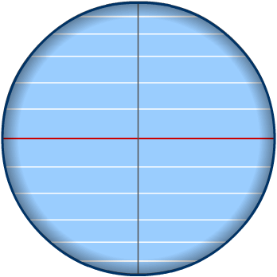
Tropics and Circles
Each east-west line represents an imaginary ring around the world. As you move towards the poles, these rings get smaller.
Certain latitudes have specific names:
Arctic Circle (66° 30' N)
Tropic of Cancer (23° 30' N)
Tropic of Capricorn (23° 30' S)
Antarctic Circle (66° 30' S)

Slide 7
Lines of latitude

Slide 8
Latitude names
Notes:
Worksheets: The worksheet Longitude and Latitude accompanies this slide.

Slide 9
Latitude and longitude co-ordinates
How can we find the position of the location marked as A?
Find its latitude.
The latitude is 20°S. A is 20° south of the equator.
Find its longitude.
The longitude is 20°W. A is 20° west of the Prime Meridian.
Combine the values for latitude and longitude.
The latitude and longitude of A is 20°S 20°W.
80
N
60
40
20
0
20
A
40
60
80
80
60
40
20
0
20
40
Always write latitude values first.

Slide 10
Latitude and longitude
Match the places with the correct latitude and longitude.

Slide 11
Describing positions

Slide 12
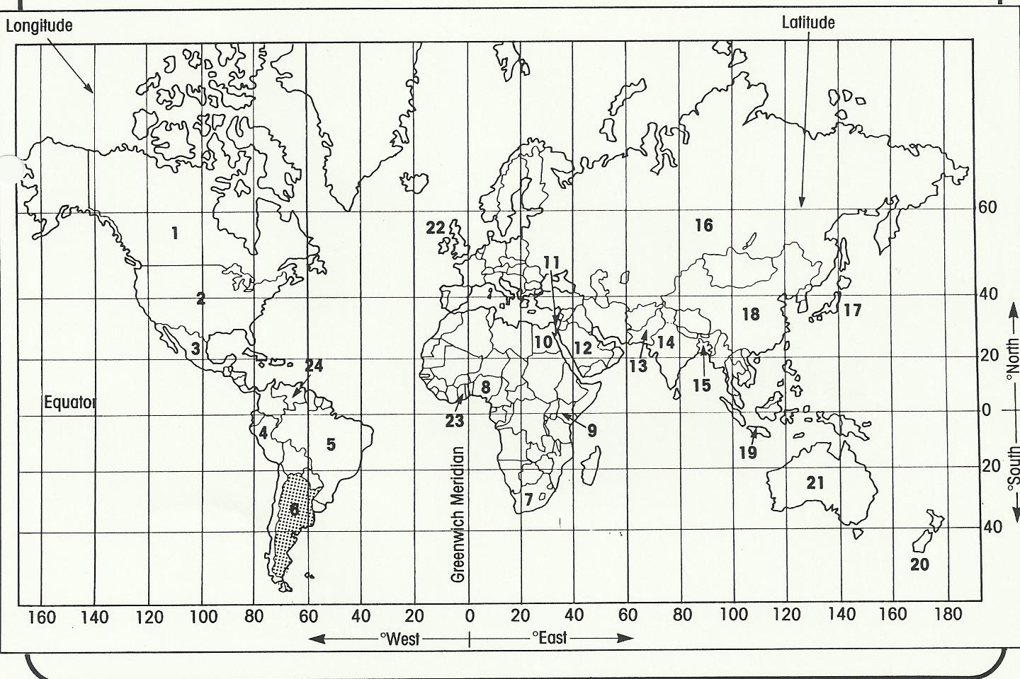
ACTIVITY
You will need an atlas for this atlas race.
1. Complete the table showing the country, latitude and longitude, first!
2. Colour in each country as you find it. No. 6 has been done to help you.
Notes:
Teacher’s note: Divisions are based on the 2005 Oxford Student Atlas © OUP. Some texts/atlases refer to the continent ‘Oceania’ as ‘Australasia’.

Slide 13
Anagrams

