Slide 1
Managing Disparities
LO
To outline ways in which development and quality of life disparities are managed by appropriate aid, intermediate technology, fair and free trade and debt relief.

Slide 2
How can we best reduce the development gap?
Reduce levels of corruption
Improve education
Methods to reduce the development gap?
Exploit new resources
Encourage economic growth
Donate money
Fairer trade agreements

Slide 3
Aid:
What is aid?
- Aid is the transfer of money, goods and expertise to assist the development of LICs and improve the quality of life

Slide 4
Types of aid and how it works…
Three types of official aid
- Multilateral aid:
- Bilateral aid:
- Voluntary aid:

Slide 5
How can trade close the gap
Gaining access to foreign markets allows a country to trade and therefore improves its ability to gain a higher GDP.

Slide 6
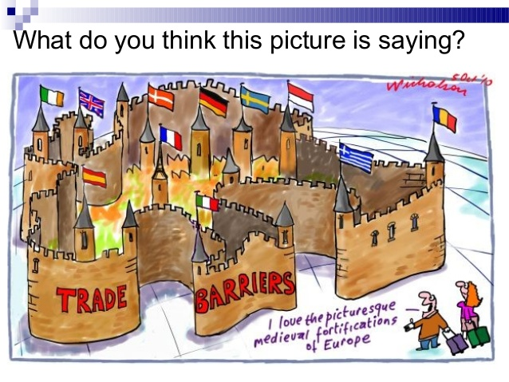
What is a trade barrier?
Certain taxes, called tariffs are usually required to gain access to a foreign market and can therefore limit a country’s ability to trade

Slide 7
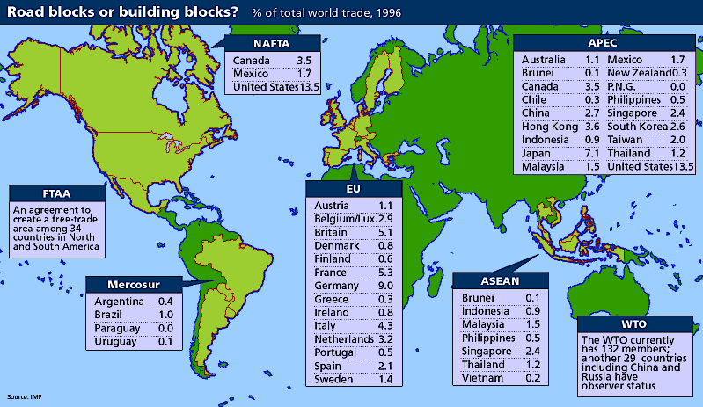
Trade Bloc’s – help to promote free trade

Slide 8
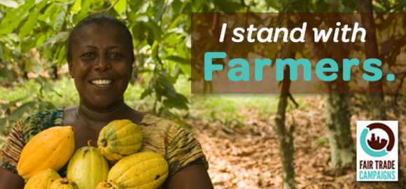
Fair Trade

Slide 9
Read pages 260 & 261, answer the following
Define what aid is
What is multilateral aid and how does it work?
What is bilateral aid and how does it work?
Give an example of bilateral aid
Why might lending large sums of money to a poor country not be a good form of aid?
How might an LIC be negatively affected by bilateral aid?
Explain the term intermediate technology
Give an example of intermediate technology and explain how it has helped
Explain the term appropriate aid
What is voluntary aid? Give an example?
What is a trade barrier and how might it negatively affect an LIC?
What is a trade bloc and how might it help a LIC? Give an example
What is the Fairtrade movement and how does this aim to help?
Describe the pattern of international aid providers and receivers on figure 9.29

Slide 10
Homework: finish questions from class, then make a table for some of the general advantages and disadvantages of foreign aid, like this one. Try to think of as many points as you can.
Advantages | Disadvantages
Voluntary aid can often save lives during a natural disaster Bilateral aid may involve technical advice or education which allows the country to develop Intermediate technology may help a country to help themselves. Voluntary aid may include funding to build schools and therefore improving education | Loans given through multilateral aid often means a country can get into debt Bilateral aid often has strings attached which may not always be beneficial for the country Aid is not always distributed fairly due to corrupt governments Voluntary aid may make a country dependent on it. Some aid might not be appropriate, e.g. technology that can’t be used

Slide 11
Examples of Aid
LO
To review two case study examples of different aid agencies and to understand how they operate

Slide 12
Two Case Studies
Aid Agency project – The World Bank (Multilateral aid)
http://study.com/academy/lesson/the-world-bank-imf-other-international-banking-organizations.html
An NGO (Non-Government Organisation) Project – Oxfam (Voluntary aid)
https://www.youtube.com/watch?v=LPoIh4gSEmA

Slide 13
Read pages 260 & 261, answer the following
Read pages 260 & 261, answer the following
Define what aid is
What is multilateral aid and how does it work?
What is bilateral aid and how does it work?
Give an example of bilateral aid
Why might lending large sums of money to a poor country not be a good form of aid?
How might an LIC be negatively affected by bilateral aid?
Explain the term intermediate technology
Give an example of intermediate technology and explain how it has helped
Explain the term appropriate aid
What is voluntary aid? Give an example?
What is a trade barrier and how might it negatively affect an LIC?
What is a trade bloc and how might it help a LIC? Give an example
What is the Fairtrade movement and how does this aim to help?
Describe the pattern of international aid providers and receivers on figure 9.29
Define what aid is
What is multilateral aid and how does it work?
What is bilateral aid and how does it work?
Give an example of bilateral aid
Why might lending large sums of money to a poor country not be a good form of aid?
How might an LIC be negatively affected by bilateral aid?
Explain the term intermediate technology
Give an example of intermediate technology and explain how it has helped
Explain the term appropriate aid
What is voluntary aid? Give an example?
What is a trade barrier and how might it negatively affect an LIC?
What is a trade bloc and how might it help a LIC? Give an example
What is the Fairtrade movement and how does this aim to help?
Describe the pattern of international aid providers and receivers on figure 9.29

