Slide 1
Managing Population Growth
LO:
To explain how government policies attempt to manage population change.

Slide 2
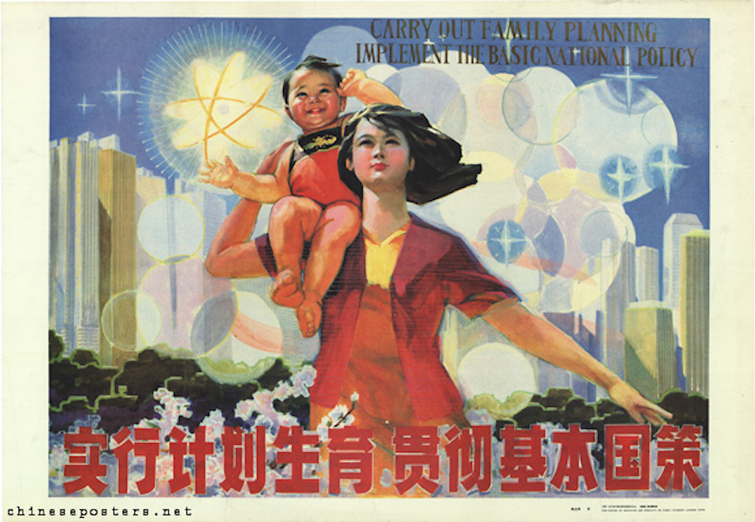
https://www.youtube.com/watch?v=UW79AIbgufo

Slide 3
Case study fact file
Finish for Homework
Why did China create the one child policy?
What were some of the key dates? Leading to/during/after
How did the government enforce/encourage the policy?
What have been some of the impacts of the policy? Create a table for this
How has the policy changed in recent years
Is the policy still used today?
 | Positive impacts | Negative impacts
Social
Economic
Demographic

