Slide 1
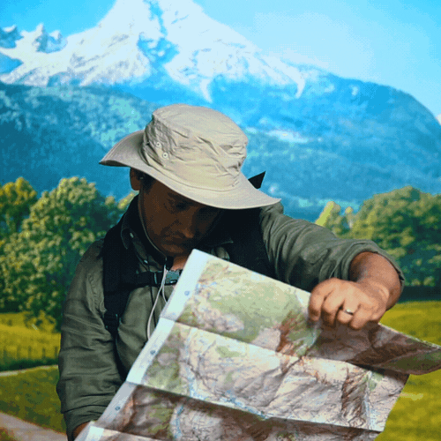
COMPASS DIRECTION & SCALE
#nevereatshreddedwheat

Slide 2
LEARNING OBJECTIVES
TITLE: COMPASS DIRECTION & SCALE
DATE:
AF2: TO KNOW THE DIRECTIONS ON A COMPASS AND KNOW HOW TO MEASURE DISTANCE ON A MAP
ALL (WTE/WTE+) STUDENTS WILL KNOW THE FOUR POINT COMPASS.
MOST (ME/ME+) STUDENTS WILL KNOW A FOUR & EIGHT POINT COMPASS AND BE ABLE TO ACCURATELY MEASURE STRAIGHTLINE DISTANCE ON A MAP.
SOME (EE/EE+) STUDENTS WILL KNOW A FOUR & EIGHT POINT COMPASS AND BE ABLE TO ACCURATELY MEASURE ANY DISTANCE ON A MAP.
LEARNING OUTCOMES
SCF: Communication & Collaboration

Slide 3
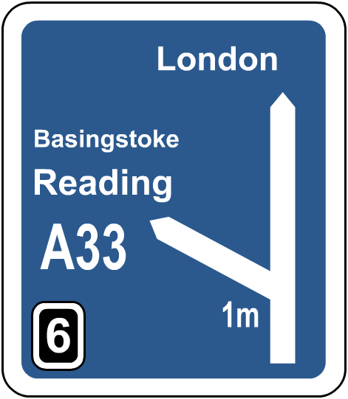

When do you use a scale?
Anyone who has ever used a map to find their way will know the importance of a scale.
Knowing which direction to travel in is only part of using a map.
To know how far it is to your destination, you need to use a map’s scale.
What do we mean by the term scale?

Slide 4
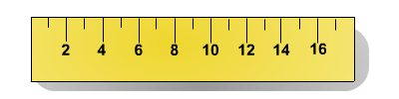
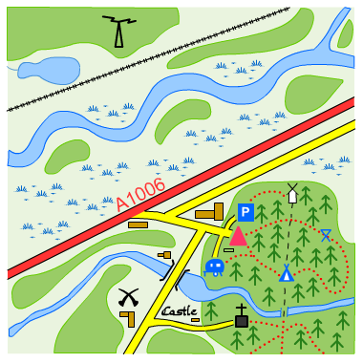
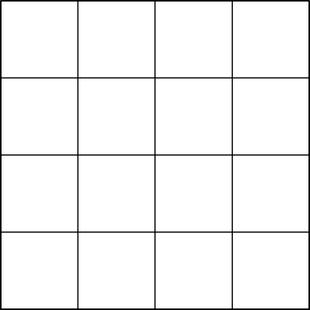
What is a scale?
Scale is the ratio of the size of objects on a map compared to their size in the real world.
For example on a map with the scale 4 cm : 1 km, four centimetres on the map represents one kilometre in the real world.
4 cm:1 km

Slide 5
How do you use the scale on a map?
Any method of estimating distance on a map requires the use of a scale.
On this map each grid box is 4 cm wide and long.
Using the scale, we know each grid box represents 1 km in distance on the ground.
How far is it from A to B if each grid square is 1 km?
A
B
scale of this map:
4 cm : 1 km
A to B is a distance of 4 km.

Slide 6
Map measuring
It is more difficult to estimate the distance between two points if they are on a diagonal.
X
What is the distance between X and Y?
Y
Using a ruler, measure the distance between the two points.
This distance is 12 cm on the map.
How far is it between X and Y in real life?

Slide 7
Calculating distance using a scale
The scale on the map is 4 cm : 1 km which means that:
X
Y
4 cm : 1 km
8 cm : 2 km
12 cm : 3 km
16 cm : 4 km
If the distance on the map is 12 cm, how many kilometres is it in real life?

Slide 8


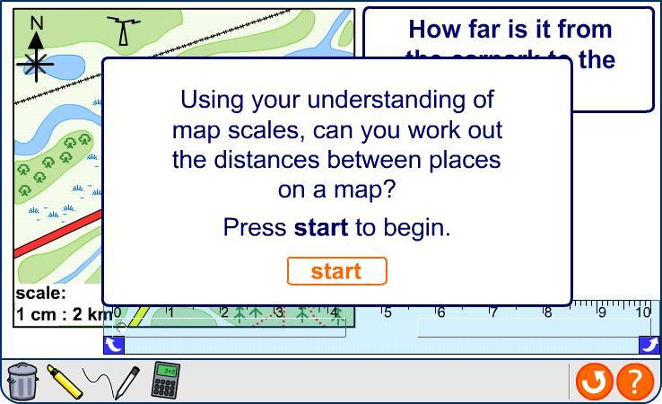
Measuring and calculating with scale
Notes:
Worksheet: The worksheet Map Measuring accompanies this slide.

Slide 9
Scale lines
We can also show scale on a map by using a scale line like this one:
0
1km
The scale line on this map shows how far 1 km on the ground appears to be on the map.
This line can then be used to estimate distance on the ground.
0
1km

Slide 10
Using scale lines
Using the scale line, estimate answers to these questions about distances on the map.
How far is it between A and B?
A
B
C
1 km
How far is it between B and C?
1.5 km
0
1km

Slide 11
TASK
1. COMPLETE ONE OF THE MEASURING DISTANCE/SCALE WORKSHEETS BASED UPON YOUR TARGET.

Slide 12
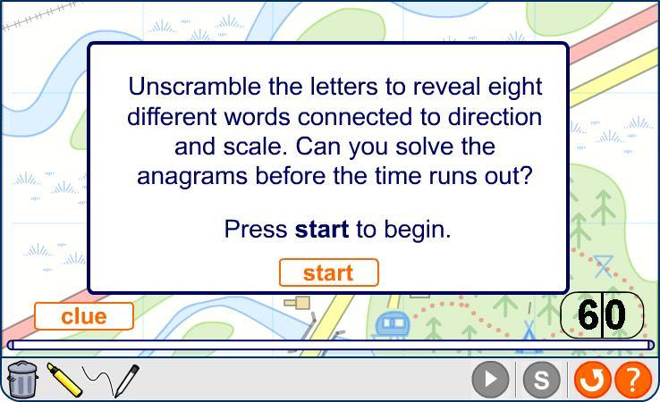
Anagrams

Slide 13
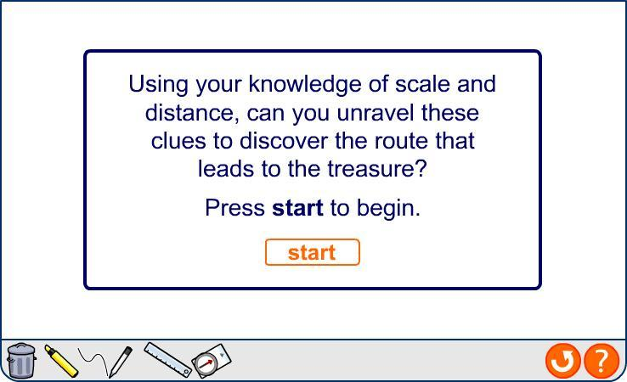
Hunt treasure with direction and scale

Slide 14
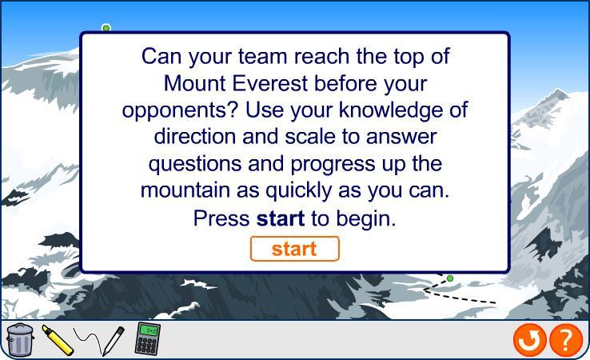
Summary quiz

