Slide 1
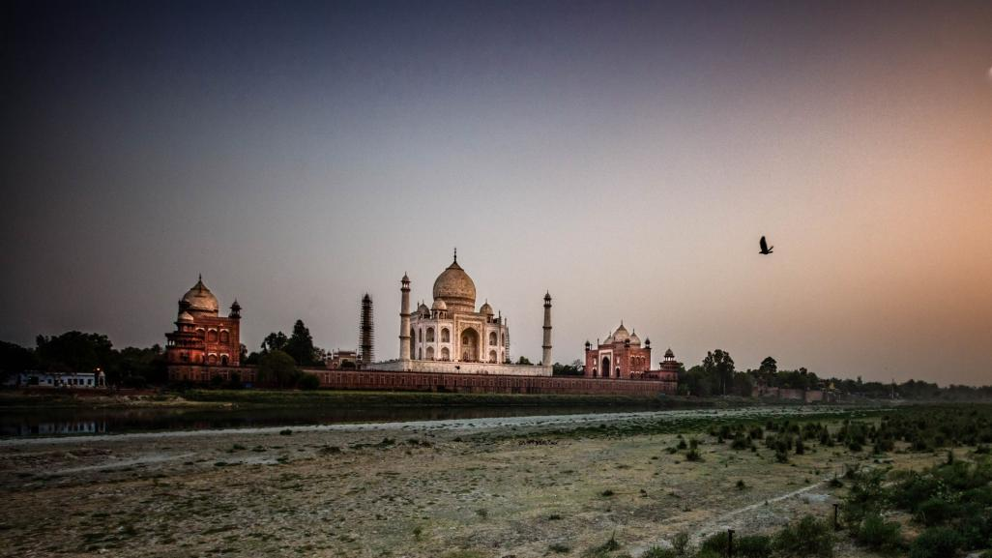

Slide 2

THE.
RISE.
OF.
INDIA.

Slide 3

LEARNING OBJECTIVES
TITLE: COULD INDIA BECOME THE NEXT SUPERPOWER?
DATE: XX/XX/XXXX
DESCRIBE (AF3) THE MAIN STRENGTHS OF INDIA AS A SUPERPOWER COUNTRY
TO DETERMINE WHETHER INDIA COULD BE A SUPERPOWER
LEARNING OUTCOMES

Slide 4
DRAW A SPIDER DIAGRAM ON YOU PAGE. HERE’S ONE I MADE EARLIER….
CURRENT PERCEPTIONS OF INDIA’S STRENGTHS FOR BEING A SUPERPOWER

Slide 5
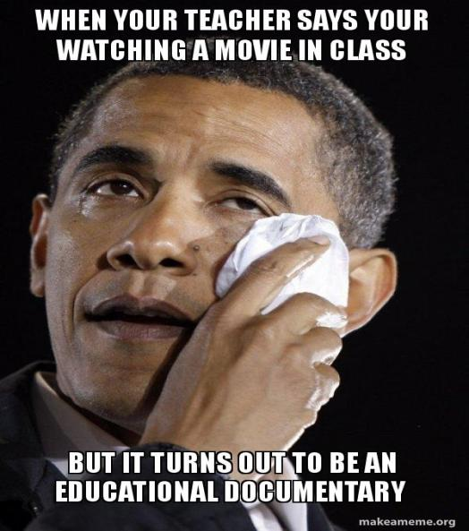
TASK
WHILE WATCHING THE DOCUMENTARY COMPLETE THE WORKSHEET IN DETAIL INDICATING THE STRENGTHS OF INDIA. THE MORE DETAIL INCLUDED = HIGHER LIKELIHOOD OF ME/EE.

Slide 6

CLICK TO PLAY!

