Slide 1
EE Grade Year 8 | AF1 Draw | Can annotate in detail with developed explanations (AF4) and detailed descriptions (AF3). Graphs are always drawn accurately. Maps and diagrams (often sequenced) are annotated to clearly explain the process. | 5 marks/5
 | AF2 Map Skills | Consistently accurate, complete maps with direction, title, key, 4 and 6 figures grid references, coordinates, scale and interpreting relief using contours, spot heights and layer shading. | 9-10 marks /10
 | AF3 Describe | Detailed descriptions that consistently uses evidence/data to support points and identifies anomalies. Patterns, landforms and features are described using visual adjectives and verbs. | 9-10 marks /10
 | AF4 Explain | Detailed explanations that identify a range of causes and consequences. These are highlighted by the use of connectives, such as using, so, this means that, because, as a result. | 9-10 marks /10
 | AF5 Evaluate | Balanced evaluation and/ or conclusion that is justified based on arguments and explanations, further supported with data. There are justified suggestions to improve, supported with evidence. A range of other view points are considered. | 9-10 marks /10
 | AF6 SPaG & Vocab | Consistently uses a range of topic specific vocabulary, spellings are always accurate and written work always has correct grammar and punctuation. | 5 marks/5

Slide 2
ME Grade Year 8 | AF1 Draw | Labels and briefs annotations with description (AF3) and beginning to explain (AF4) are added to diagrams. Graphs are usually drawn accurately but not consistent. | 3 marks /5
 | AF2 Map Skills | Maps are not always completed and there are inaccuracies with some of the following, direction, title, key, 4 and 6 figures grid references, coordinates, scale and interpreting relief. | 5-6 marks/10
 | AF3 Describe | Clear descriptions using key words and beginning to use evidence/data to support points, but it is not consistent. Patterns, landforms and features are described using suitable adjectives and verbs. | 5-6 marks/10
 | AF4 Explain | Beginning to explain by identifying the cause or the consequence, but not both. Connectives such as , so and because, are occasionally used to highlight this. | 5-6 marks/10
 | AF5 Evaluate | An evaluation is balanced/two sided, however explanations are brief with little evidence to justify the points. There are some suggestions to improve. Other view points are considered. | 5-6 marks/10
 | AF6 SPaG & Vocab | Sometimes uses topic specific vocabulary, spelling, grammar and punctuation is not consistently accurate. | 3 marks /5

Slide 3
WTE Grade Year 8 | AF1 Draw | Labels are added to sketches, no annotation. Data is rarely plotted accurately on graphs and diagrams are drawn in a sequence but lack annotation to make them clear. | 1 marks /5
 | AF2 Map Skills | Inaccuracies when plotting direction, title, key, 4 and 6 figures grid references, coordinates, scale onto maps and interpreting relief. | 1-2 marks/10
 | AF3 Describe | Brief descriptions with limited adjectives to describe landforms and patterns. No evidence or data is used to support the description. | 1-2 marks/10
 | AF4 Explain | Brief reasons, maybe listed with no connectives used to identify the cause and consequences of a process. | 1-2 marks/10
 | AF5 Evaluate | An unbalanced evaluation/one sided, no conclusion, points are briefly explained with no further supporting data or evidence. Other view points are not taken into consideration. | 1-2 marks/10
 | AF6 SPaG & Vocab | Rarely uses topic specific vocabulary, spellings are inaccurate with many grammar and punctuation errors. | 1 marks /5

Slide 4
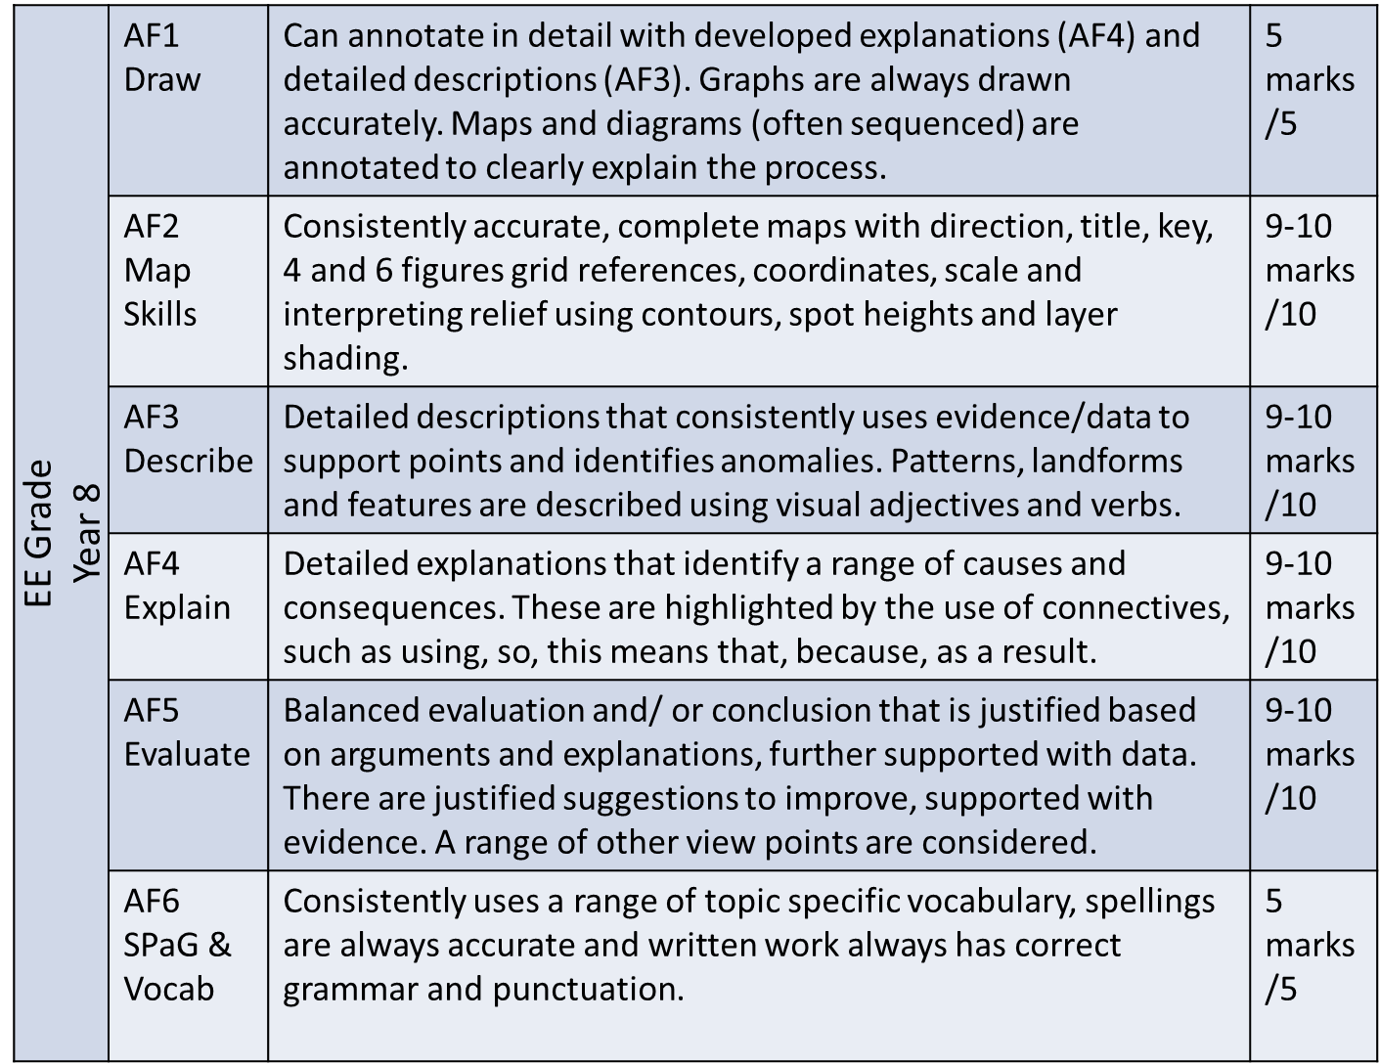
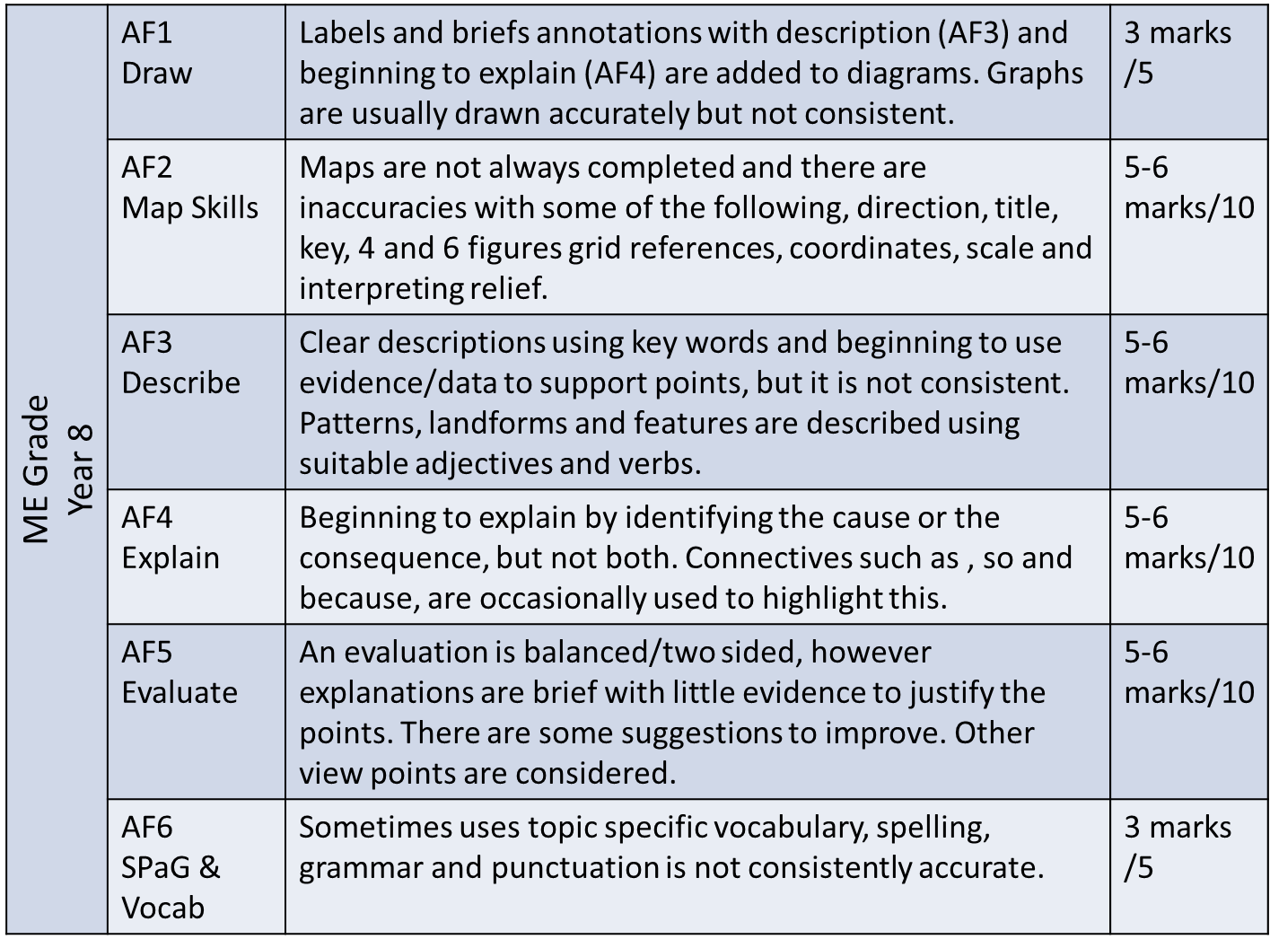
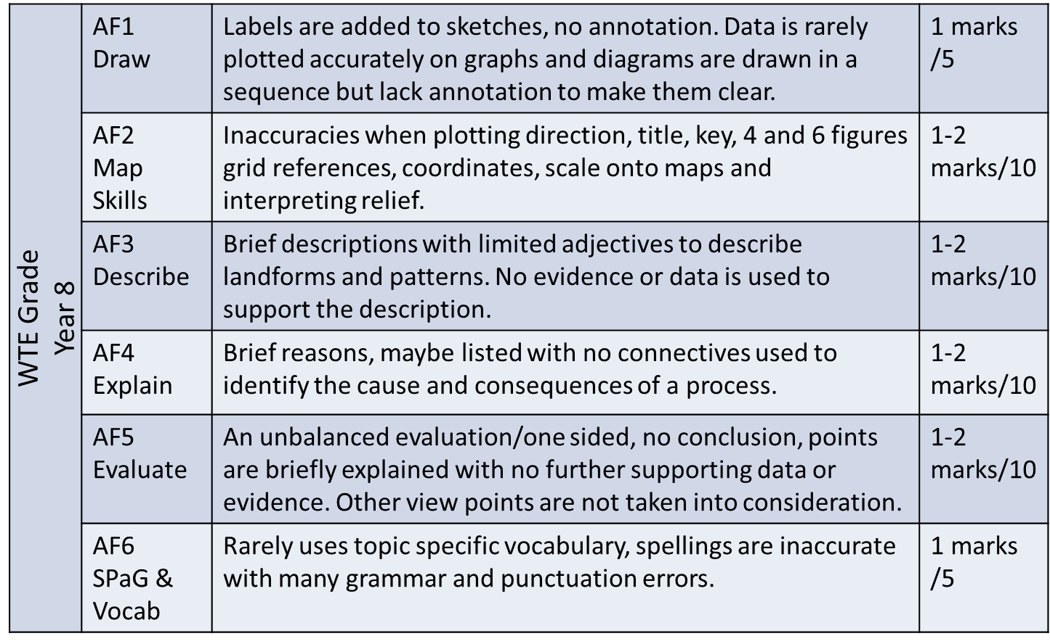
YEAR 8
Success Criteria
What can I do to improve?

