Slide 1
EE Grade Year 9 | AF1 Draw | Can annotate in detail with developed explanations (AF4) and detailed descriptions (AF3). Graphs are always drawn accurately. Maps and diagrams (often sequenced) are annotated to clearly explain the process. | 5 marks/5
 | AF2 Map Skills | Consistently accurate, complete maps with direction, title, key, 4 and 6 figures grid references, coordinates, scale and interpreting relief using contours, spot heights and layer shading. | 9-10 marks /10
 | AF3 Describe | Detailed descriptions that consistently uses evidence/data to support points and identifies anomalies. Patterns, landforms and features are described using visual adjectives and verbs. | 9-10 marks /10
 | AF4 Explain | Detailed explanations that identify a range of causes, consequences and responses. These are highlighted by the use of connectives, such as using, so, this means that, because, as a result. | 9-10 marks /10
 | AF5 Evaluate | Balanced evaluation and/ or conclusion that is justified based on arguments and explanations, further supported with data. There are justified, sustainable suggestions to improve, supported with evidence. A range of other view points are considered. | 9-10 marks /10
 | AF6 SPaG & Vocab | Consistently uses a range of topic specific vocabulary, spellings are always accurate and written work always has correct grammar and punctuation. | 5 marks/5

Slide 2
ME Grade Year 9 | AF1 Draw | Labels and briefs annotations with description (AF3) and beginning to explain (AF4) are added to diagrams. Graphs are usually drawn accurately but not consistent. | 3 marks /5
 | AF2 Map Skills | Maps are not always completed and there are inaccuracies with some of the following, direction, title, key, 4 and 6 figures grid references, coordinates, scale and interpreting relief. | 5-6 marks/10
 | AF3 Describe | Clear descriptions using key words and beginning to use evidence/data to support points, but it is not consistent. Patterns, landforms and features are described using suitable adjectives and verbs. | 5-6 marks/10
 | AF4 Explain | Beginning to explain by identifying the cause, consequence and response, but balanced. Connectives such as , so and because, are occasionally used to highlight this. | 5-6 marks/10
 | AF5 Evaluate | An evaluation is balanced/two sided, however explanations are brief with little evidence to justify the points. There are some suggestions to improve that consider sustainability. Other view points are considered. | 5-6 marks/10
 | AF6 SPaG & Vocab | Sometimes uses topic specific vocabulary, spelling, grammar and punctuation is not consistently accurate. | 3 marks /5

Slide 3
WTE Grade Year 9 | AF1 Draw | Labels are added to sketches, no annotation. Data is rarely plotted accurately on graphs and diagrams are drawn in a sequence but lack annotation to make them clear. | 1 marks /5
 | AF2 Map Skills | Inaccuracies when plotting direction, title, key, 4 and 6 figures grid references, coordinates, scale onto maps and interpreting relief. | 1-2 marks/10
 | AF3 Describe | Brief descriptions with limited adjectives to describe landforms and patterns. No evidence or data is used to support the description. | 1-2 marks/10
 | AF4 Explain | Brief reasons, maybe listed with no connectives used to identify the cause, consequences and responses of a process. | 1-2 marks/10
 | AF5 Evaluate | An unbalanced evaluation/one sided, no conclusion, points are briefly explained with no further supporting data or evidence. No suggestions to improve and no mention of sustainability. Other view points are not taken into consideration. | 1-2 marks/10
 | AF6 SPaG & Vocab | Rarely uses topic specific vocabulary, spellings are inaccurate with many grammar and punctuation errors. | 1 marks /5

Slide 4
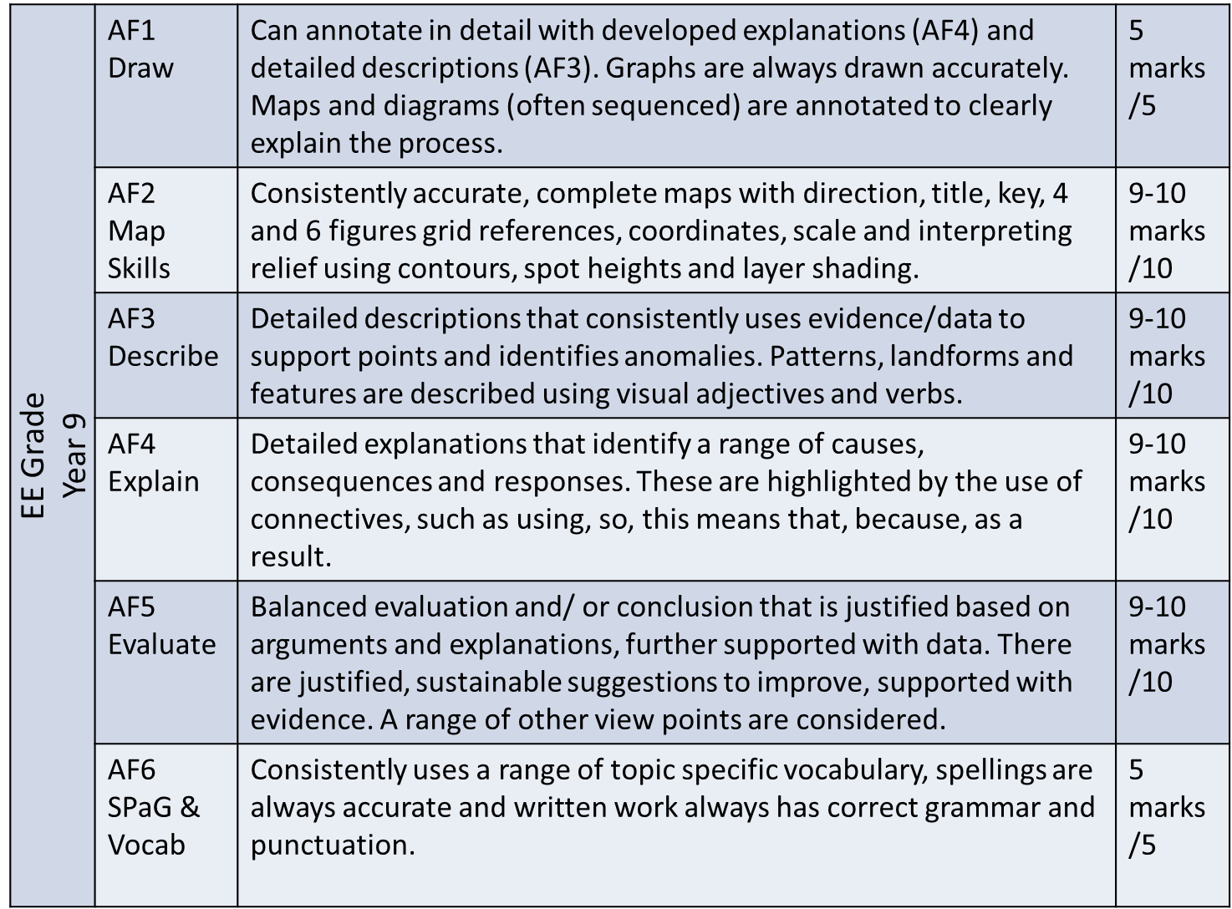
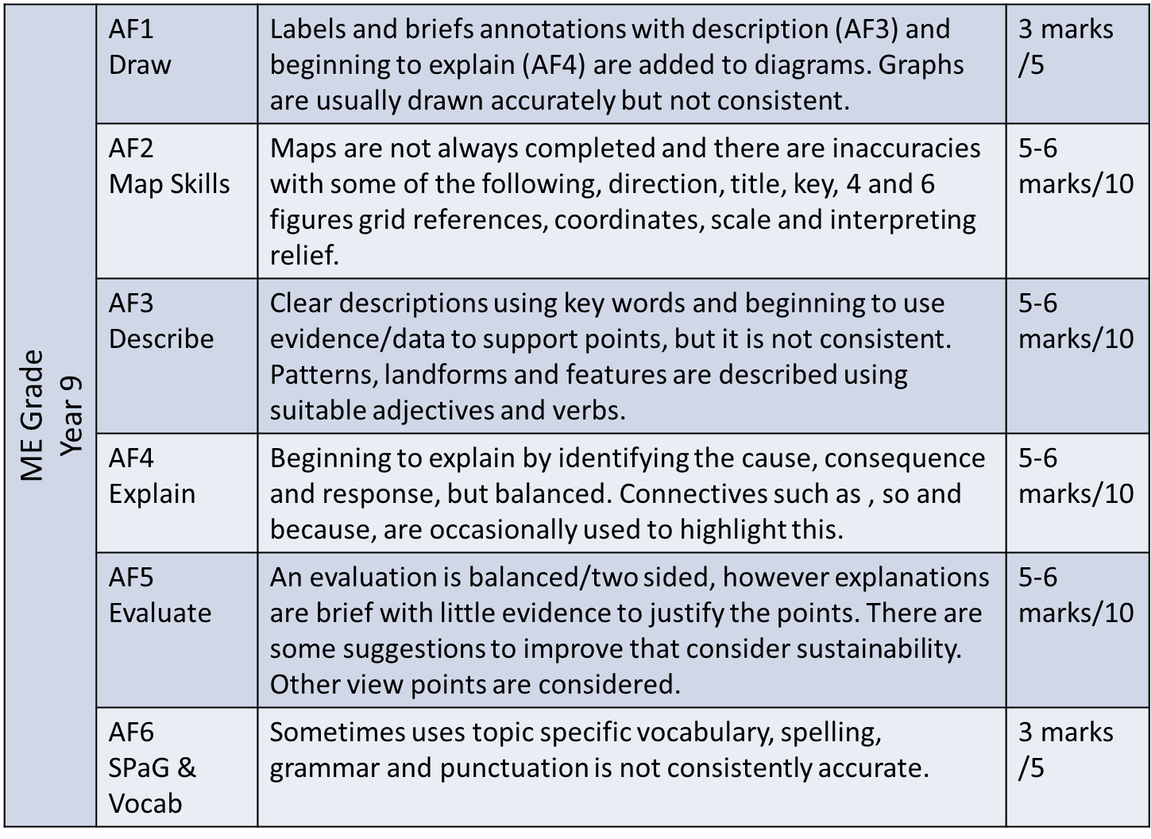
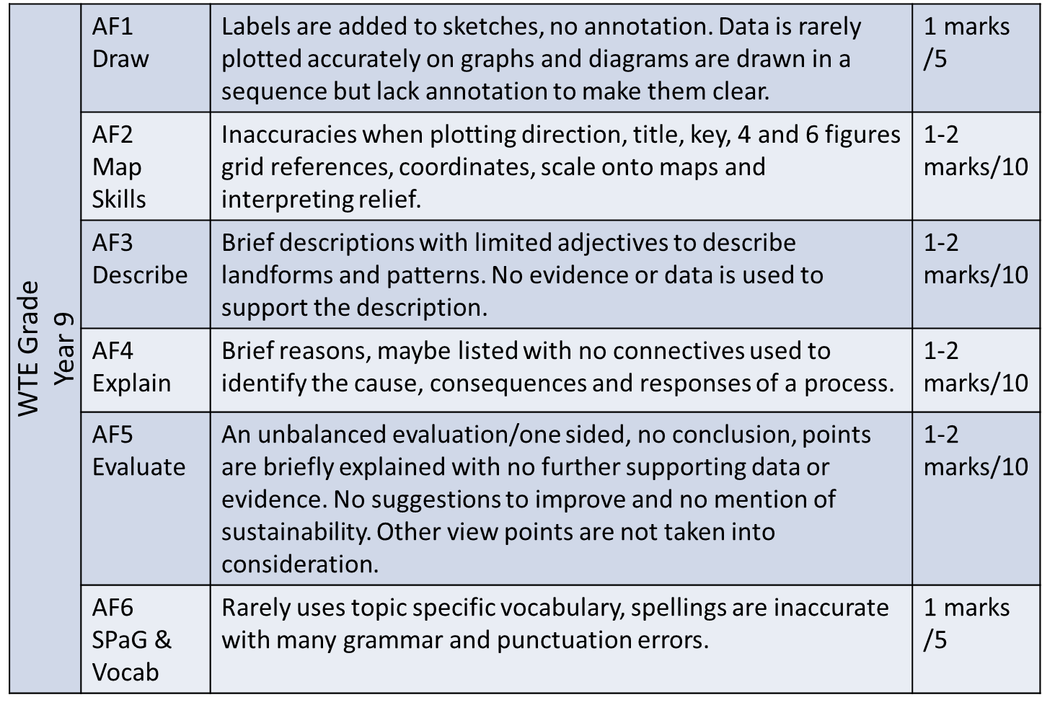
YEAR 9
Success Criteria
What can I do to improve?

